Slide 1
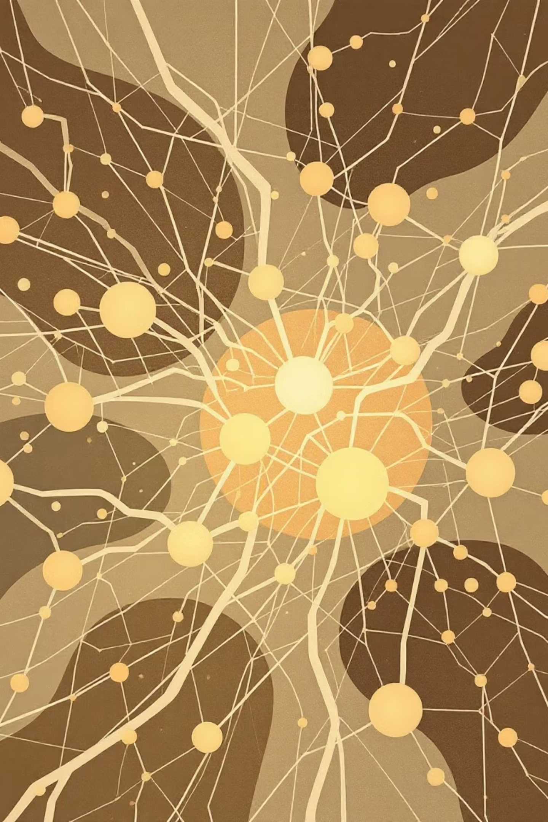
Introduction to Neural Networks
Understanding the fundamentals of artificial intelligence through brain-inspired computing systems

Slide 2
Learning Outcomes
By the end of this module, you will be able to:
Explain the basic concepts and structure of a neural network
Compare biological and artificial neurons
Describe functioning of Neural Networks
Describe different types of neural networks and learning methods
Apply neural networks to classification and regression tasks

Slide 3
Why Neural Networks?
Certain tasks come naturally to humans but remain remarkably challenging for traditional computers. Neural networks bridge this gap by learning patterns rather than following rigid instructions.
Pattern Recognition
Content-Addressable Recall
Common-Sense
Reasoning
Identifying faces, reading handwriting, and recognizing speech patterns
Retrieving information based on partial or imperfect inputs
Making intuitive decisions like driving in traffic or improvising music
These capabilities are ill-defined, experience-based, and nearly impossible to capture with explicit programming rules. Neural networks excel because they learn from examples and data, adapting their behavior through experience.

Slide 4
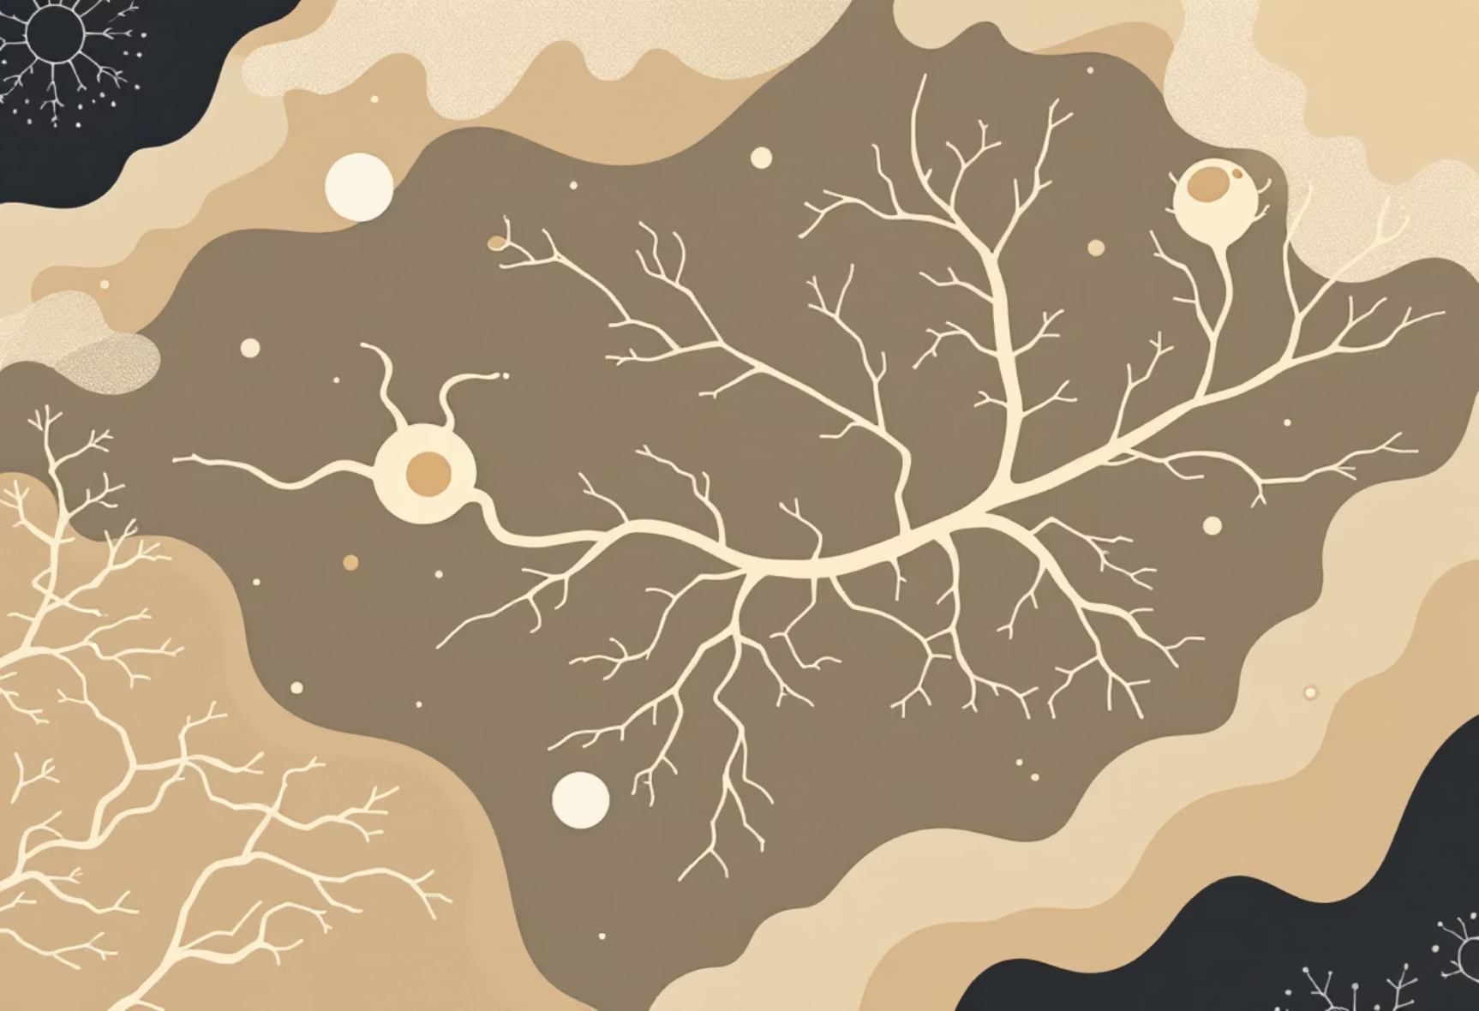
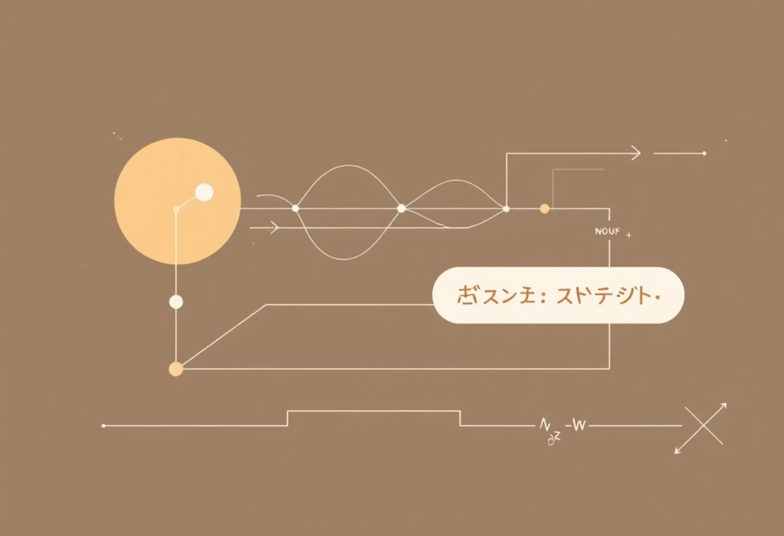
Biological Neuron
Artificial Neuron
vs.

Slide 5
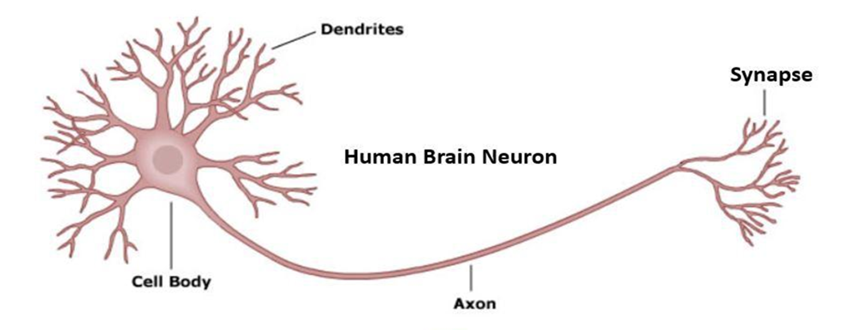
Biological Neuron

Slide 6
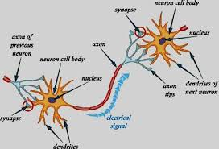

Slide 7
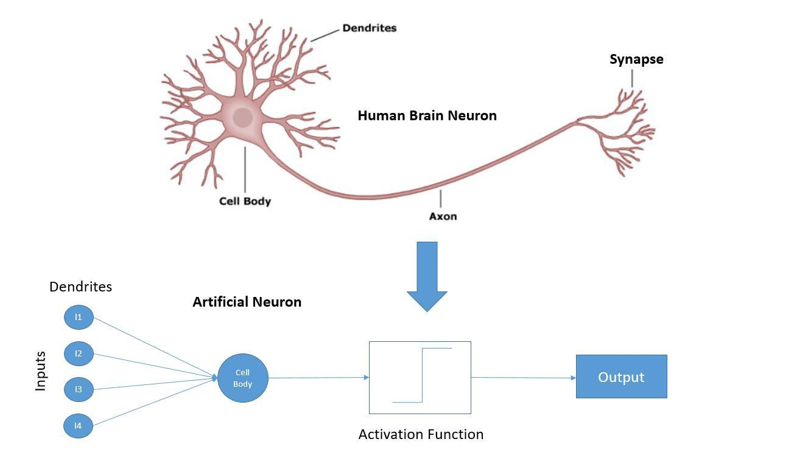
BIOLOGICAL NEURON

Slide 8
Artificial Neuron
{
W
Neuron
I N P U T S
W
Σ
f(n)
Outputs
Activation
Function
W
W
W=Weight

Slide 9
Biological Neuron
Artificial Neuron
vs.
Cell body processes signals
Inputs multiplied by weights
Dendrites receive inputs
Weighted sum calculated
Axon transmits output
Activation function applied
Synapses connect neurons
Output signal generated
Fires when input exceeds threshold
Simplified computational model
The artificial neuron is a mathematical abstraction inspired by biological neurons, designed to be simple yet powerful
when connected in a network.

Slide 10

What is a Neural Network?
A neural network is a collection of interconnected nodes (artificial neurons) linked by weighted connections. Each node performs simple mathematical operations, but together they can solve remarkably complex problems.

Slide 11
Exploring the Landscape of Modern Neural Networks
Basic Architectures
  SLP → MLP
  CNNs (Convolutional Neural Networks) → Vision tasks
  RNNs (Recurrent Neural Networks) → Sequential data (time series, NLP)
  GNNs (Graph Neural Networks) → Graph-structured data
Advanced & Generative Models
  GANs (Generative Adversarial Networks) → Image generation, synthesis
  Transformers → Language modeling, attention-based tasks (e.g., BERT, GPT)
Large Language Models (LLMs)
  ChatGPT, GPT-4, etc. → Built on Transformer architecture

Slide 12
Neural Networks Functions
01
Supervised Learning
02
Unsupervised Learning
03
Reinforcement Learning
Labeled data
No labels
Learn from interaction
Clustering → Group similar data (e.g., customer segments)
Agent-Environment Loop → Maximize reward (e.g., game playing, robotics)
Regression → Predict continuous values (e.g., price, temperature)
Classification → Predict discrete labels (e.g., spam/not spam, image class)
Dimensionality Reduction → Simplify data (e.g., PCA)

Slide 13
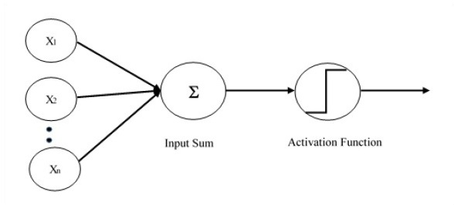

Single Layer Perceptron (SLP)
The simplest form of neural network, consisting of just an input layer connected directly to an output layer with no hidden layers in between.
Direct Input-Output Mapping
Information flows directly from inputs to outputs through weighted connections
Linear Classification
Best suited for problems where data can be separated by a straight line or plane
Simple Learning
Weights start random and adjust through training to minimize prediction errors
Limitation: Single layer perceptrons can only solve linearly separable problems—they cannot learn XOR or other non-linear patterns.

Slide 14
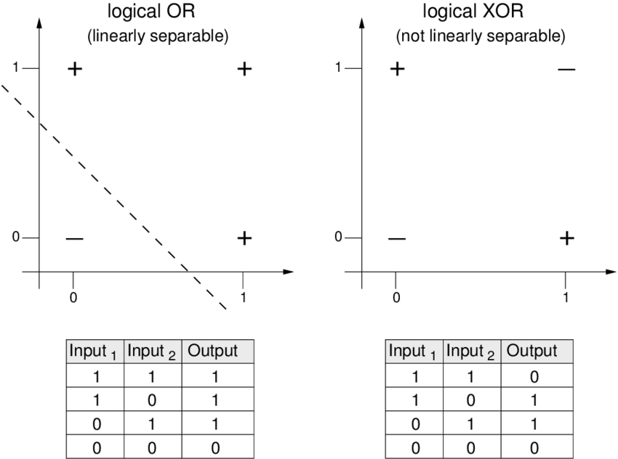

Slide 15
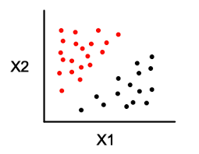
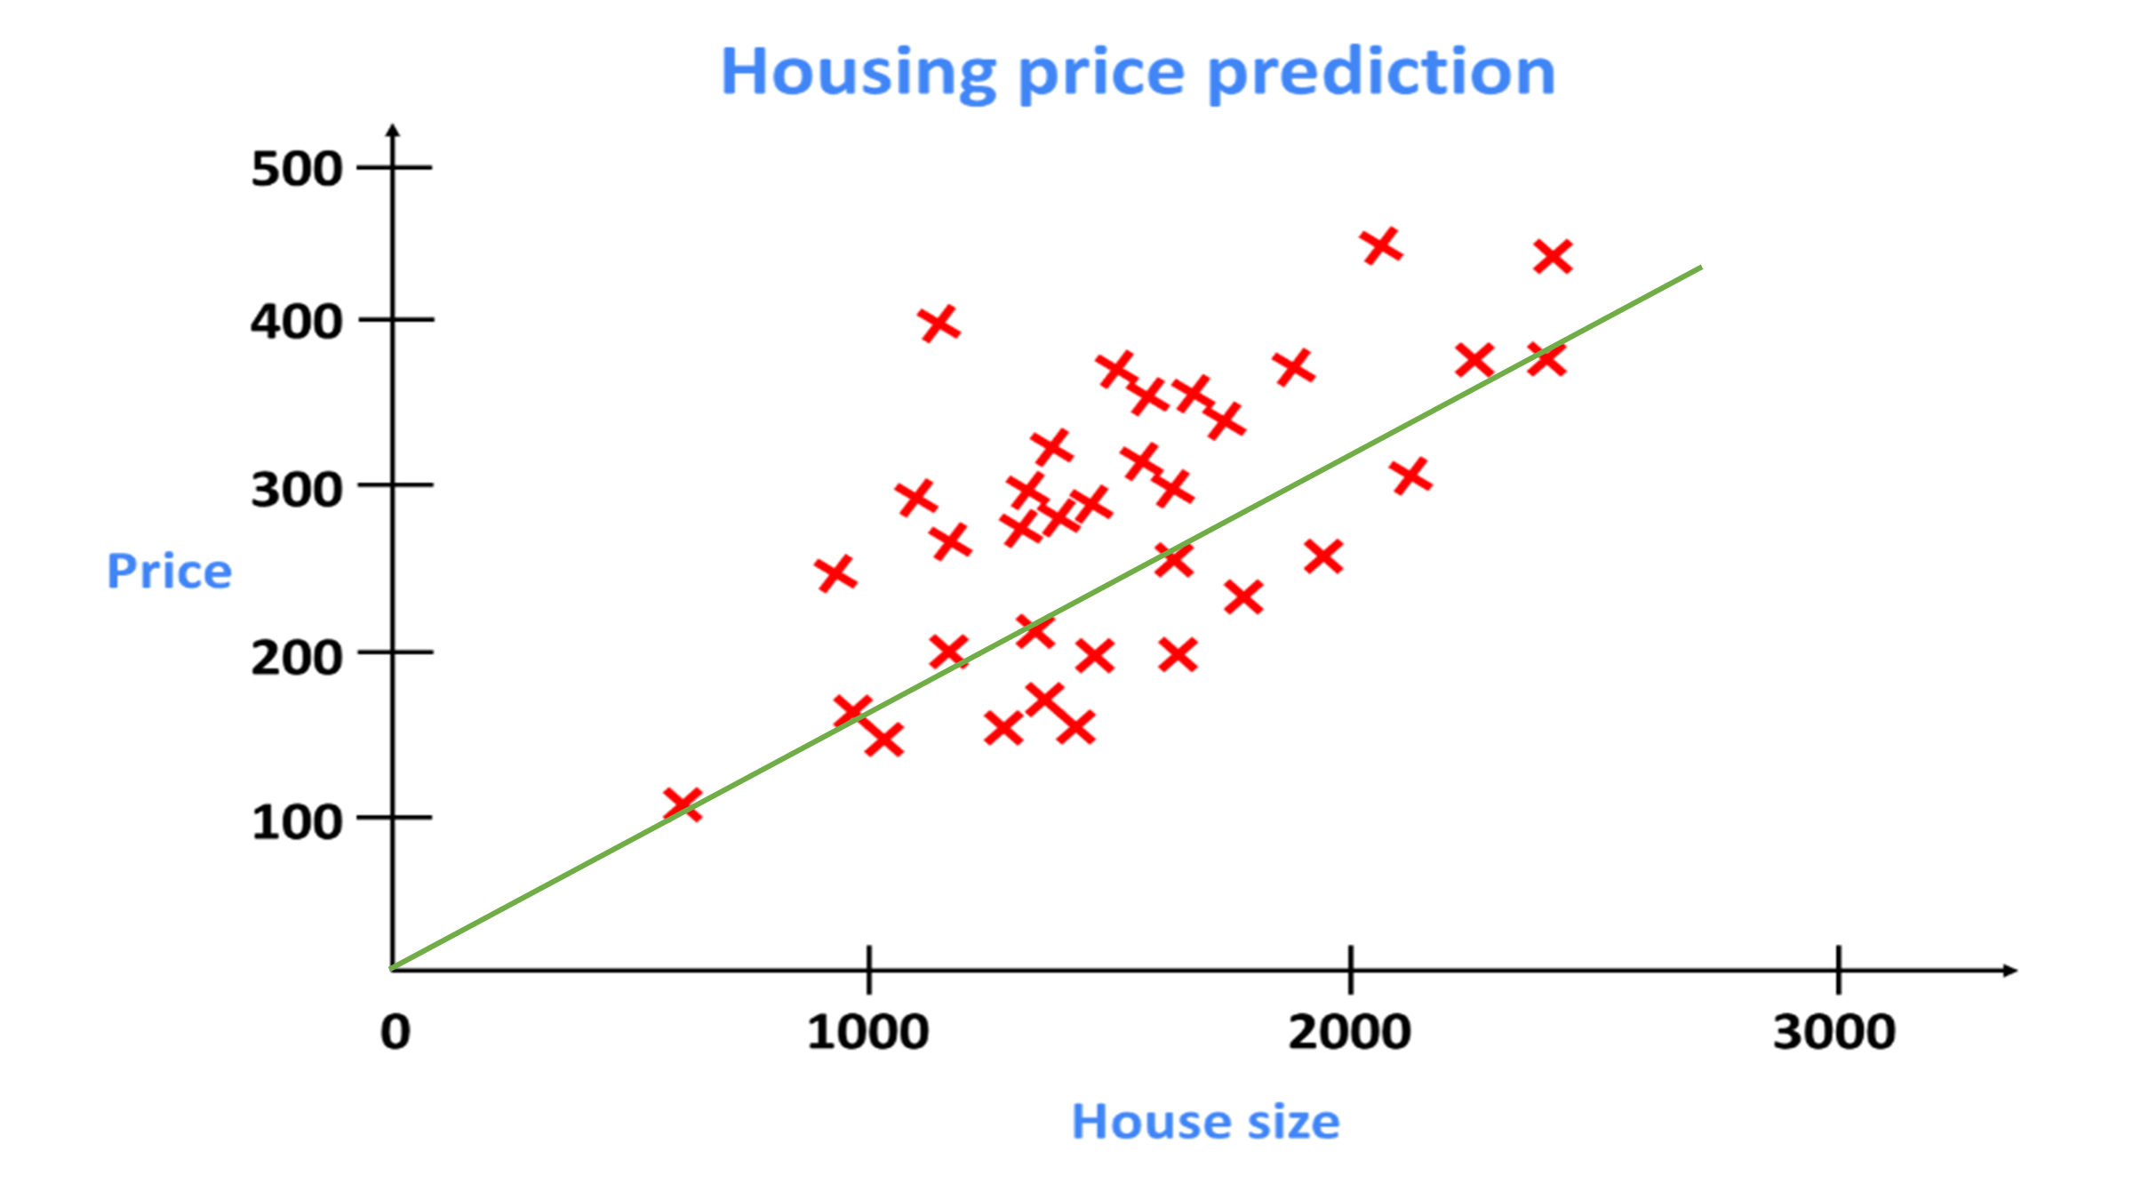
Linear Regression
Single Layer Perceptron

Slide 16
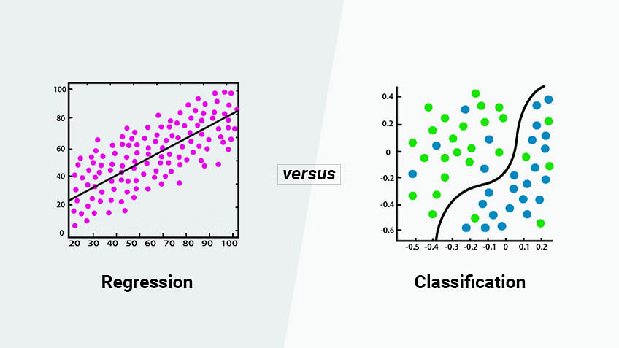

Slide 17
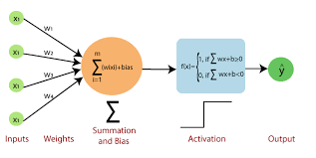
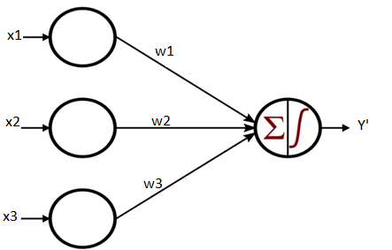
Single Layer Perceptron

Slide 18
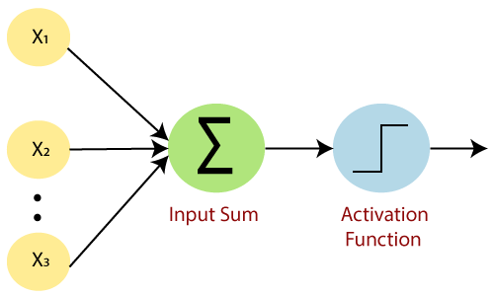
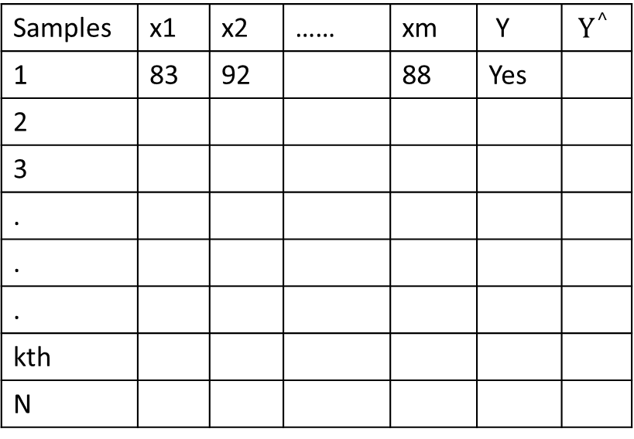
Samples | x1 | x2 | …… | xm | Y | $$Y^{^}$$
1 | 83 | 92 |  | 88 | Yes
2
3
.
.
.
kth
N

Slide 19
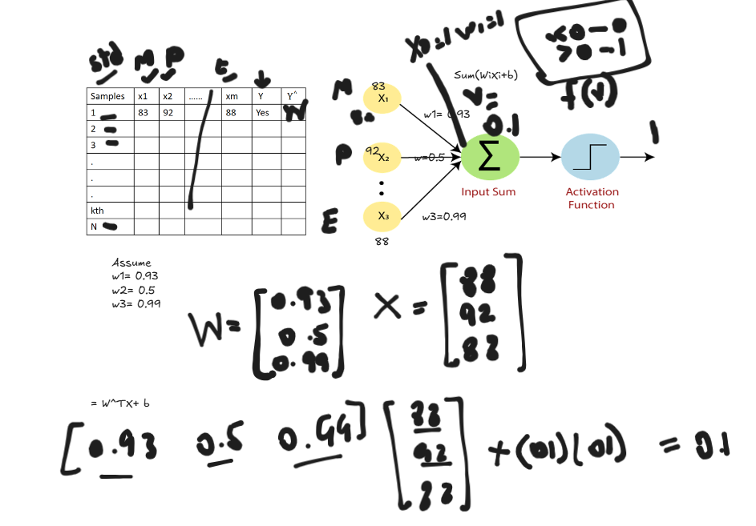

Slide 20
About Weights
It is randomly initialized i.e it is assigned a random number.
The weights is what the algorithm will LEARN.

Slide 21
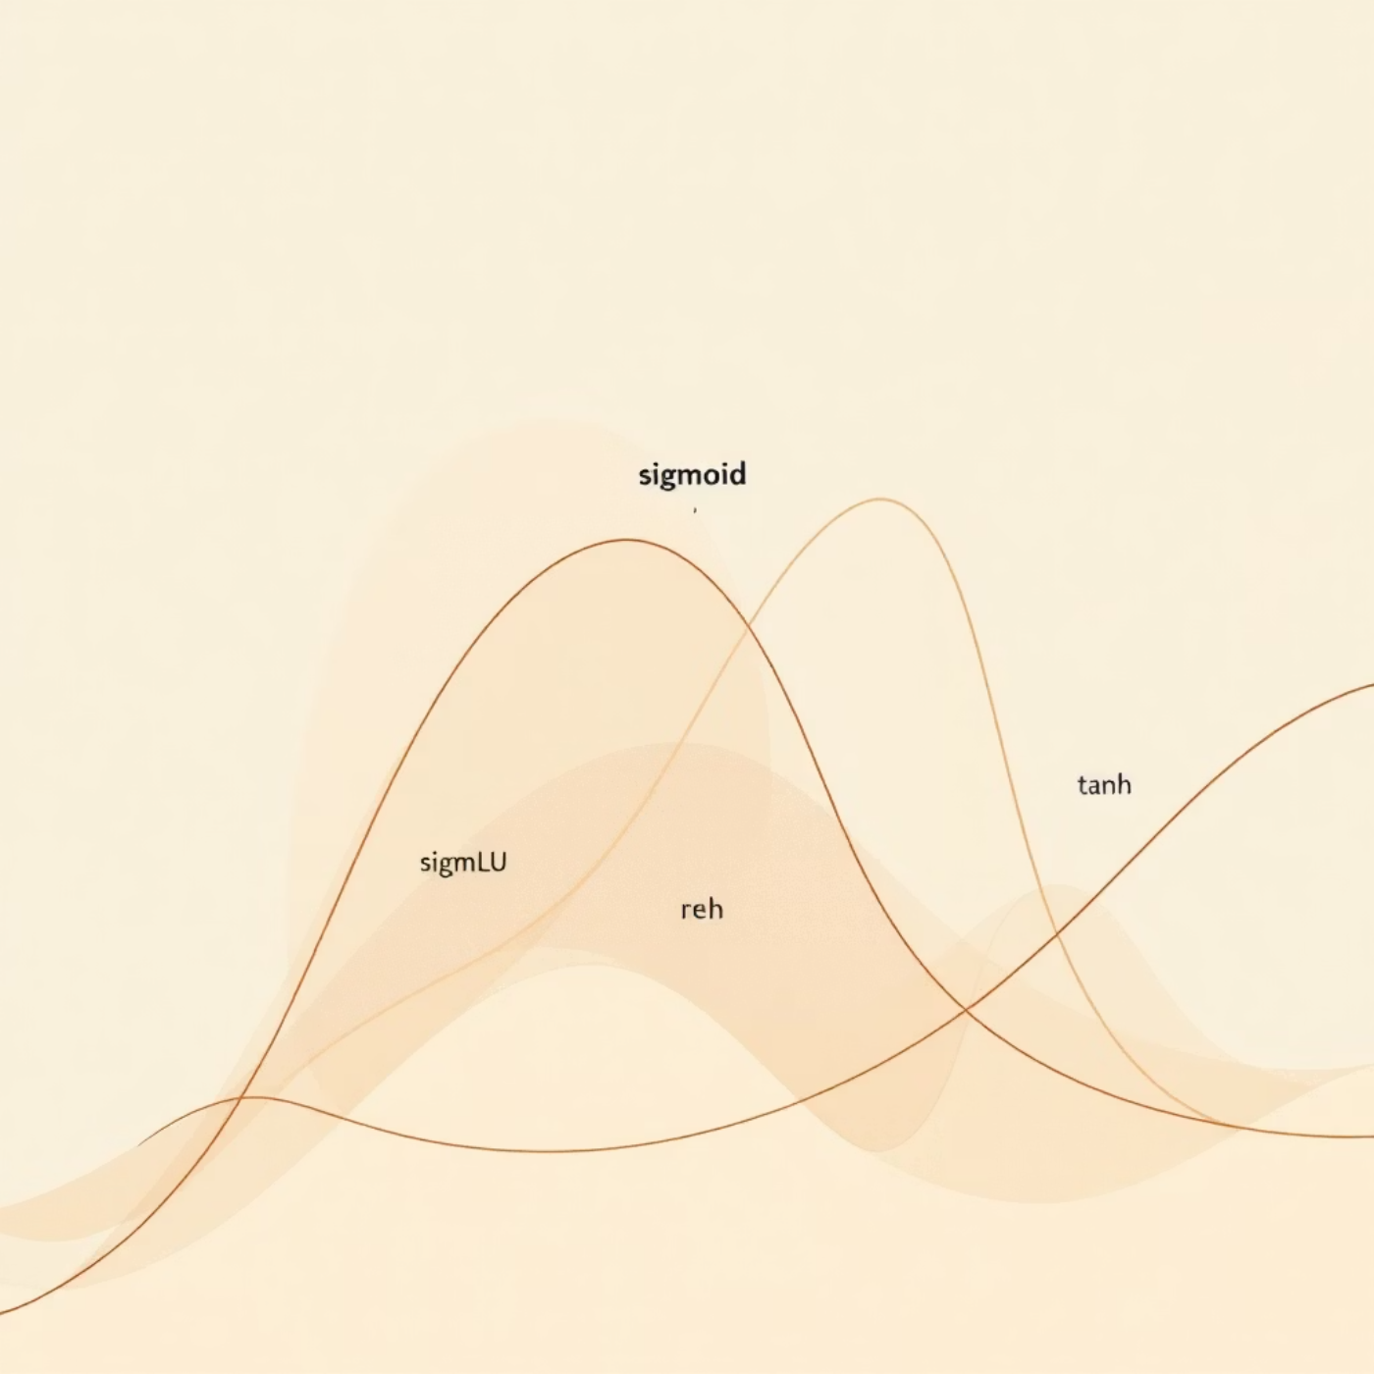
Activation Functions

Slide 22

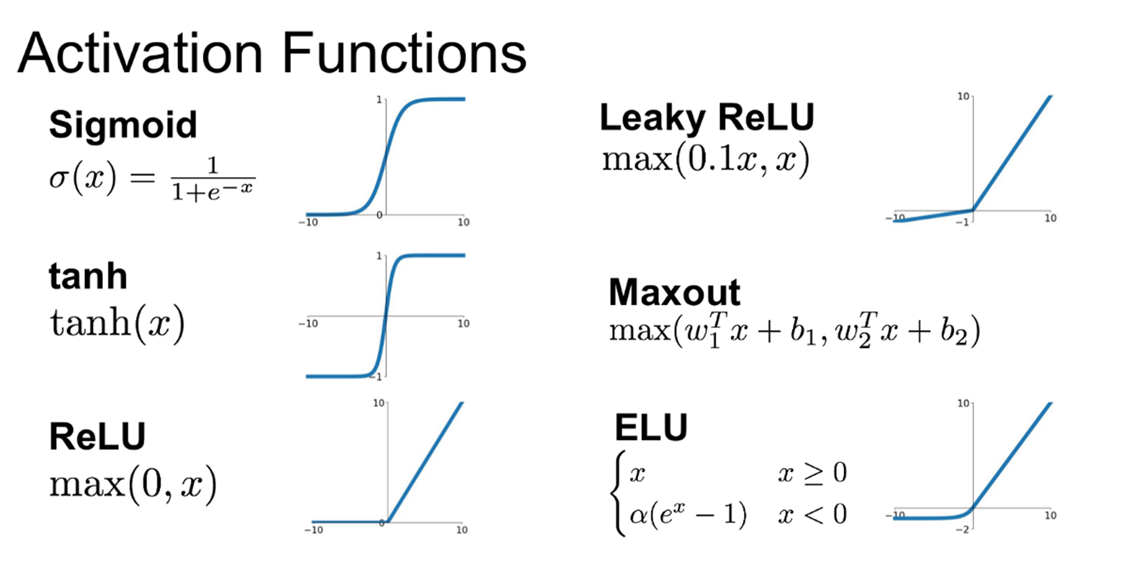

Slide 23
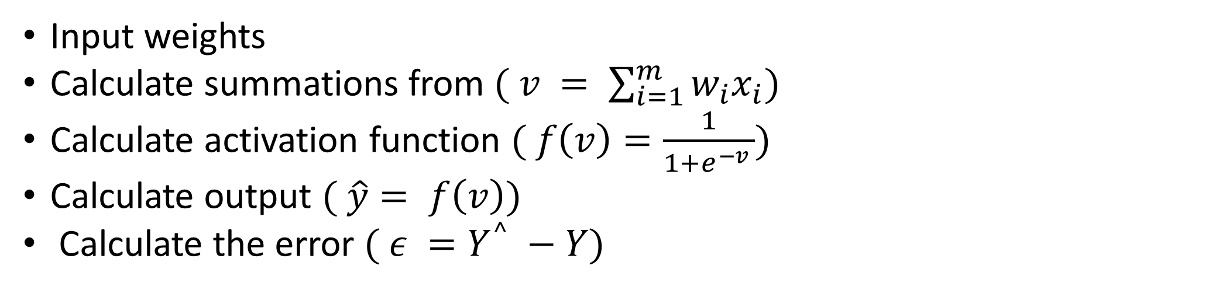
Recap so far
Input weights
Calculate summations from $( v = \sum_{i=1}^{m}{w_{i}x_{i}})$
Calculate activation function $( f\left(v\right)=\frac{1}{1+e^{−v }})$
Calculate output $( \hat{y}= f\left(v\right))$
Calculate the error $( ε =Y^{^} −Y)$

Slide 24


Backpropagation: How Neural Networks Learn
Backpropagation is the core algorithm that enables neural networks to learn from mistakes and improve their predictions over time.
1
Forward Pass
Input data flows through network to generate predictions
2
Compute Error
Compare predictions with actual target values to calculate loss
3
Backward Pass
Propagate error signal backward through network using chain rule
4
Update Weights
Adjust connection weights to minimize error for future predictions
The beauty of backpropagation lies in its use of the chain rule from calculus to efficiently compute how each weight contributes to the overall error, enabling precise adjustments throughout the entire network.

Slide 25
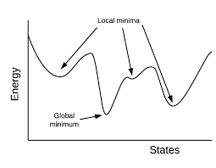

Gradient Descent: The Optimization Engine
Navigating the Error Landscape
Gradient descent is the optimization technique that determines how weights should be updated during backpropagation. Think of it as hiking down a mountain in fog—you can only see the slope beneath your feet and must decide which direction leads downward.
The algorithm calculates the gradient (slope) of the error function and adjusts weights in the direction that reduces error most rapidly.
Learning Rate
Controls step size during weight updates
Too small: Slow convergence
Too large: May overshoot minimum
Iterative Process
Repeatedly adjusts weights across many training examples
Each iteration improves predictions
Continues until error stabilizes
By combining backpropagation with gradient descent, neural networks progressively minimize prediction errors and learn to recognize patterns in data.
Notes:
Draw diagram

Slide 26




Multi-Layer Perceptron (MLP)
The workhorse of neural networks, MLPs add one or more hidden layers between input and output, enabling them to learn complex, non-linear relationships in data.
Input Layer
Receives raw data features
Hidden Layer(s)
Extracts and transforms features progressively
Output Layer
Produces final predictions or classifications
Each hidden layer allows the network to learn increasingly abstract representations. MLPs use backpropagation to adjust weights throughout all layers, making them capable of approximating virtually any continuous function.

Slide 27
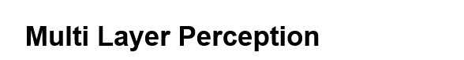
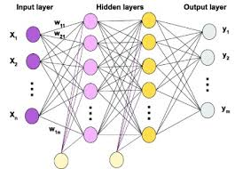

Slide 28
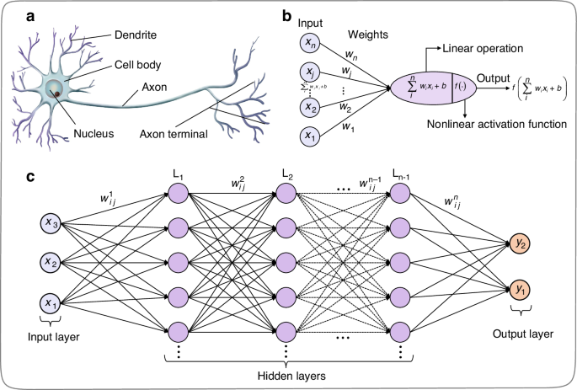

Slide 29
Applications of Neural Networks
Classification – e.g., spam detection, image recognition
Clustering – e.g., customer segmentation
Function Approximation – e.g., curve fitting
Prediction – e.g., stock prices, weather

Slide 30
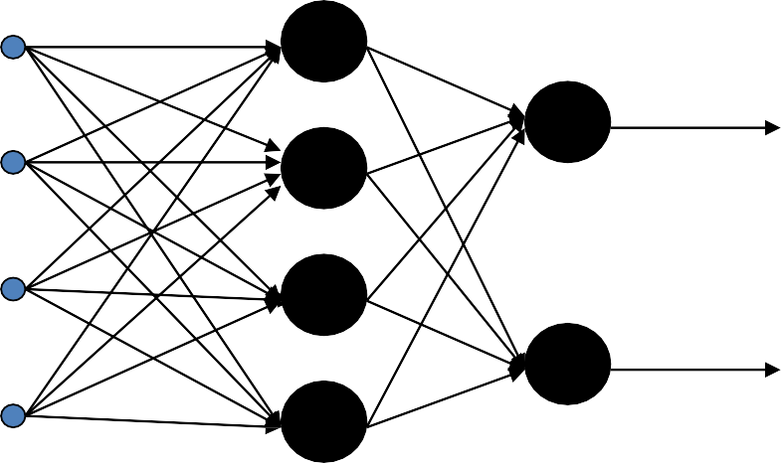
Types of networks
Multiple Inputs and Single Layer
Multiple Inputs and muliple layers

Slide 31




Types of Networks – Contd.
Feedback
Recurrent Networks

Slide 32

Multilayer Perceptron
Output Layer
Inputs
First Hidden
layer
Second Hidden
Layer

Slide 33
Signal Flow Backpropagation of Errors
Function Signals
Error Signals

Slide 34
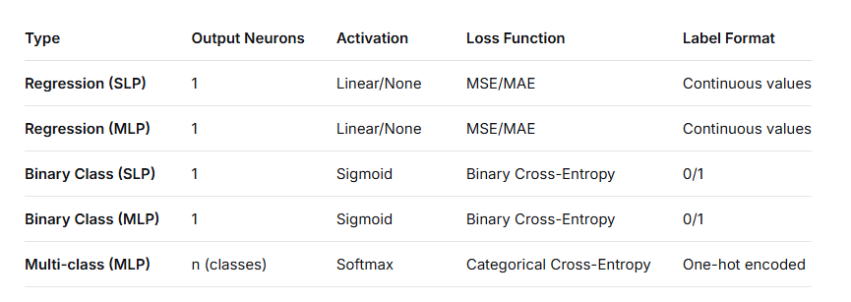

Slide 35
Summary
Key Terms
Activation Function
Backpropagation
Gradient Descent
Weight & Bias
Hyperparameter
Epoch, Batch, Learning Rate
You learned:
Basics of neural networks
Difference between biological and artificial neurons
Types of NNs and learning methods
How backpropagation works

Slide 36
References
Bishop, Christopher M. (2006). Pattern recognition and machine learning. New York :Springer
Sebastian Raschka and Vahid Mirjalili. 2017. Python Machine Learning: Machine Learning and Deep Learning with Python, scikit-learn, and TensorFlow, 2nd Edition (2nd. ed.). Packt Publishing.

